Slide 1
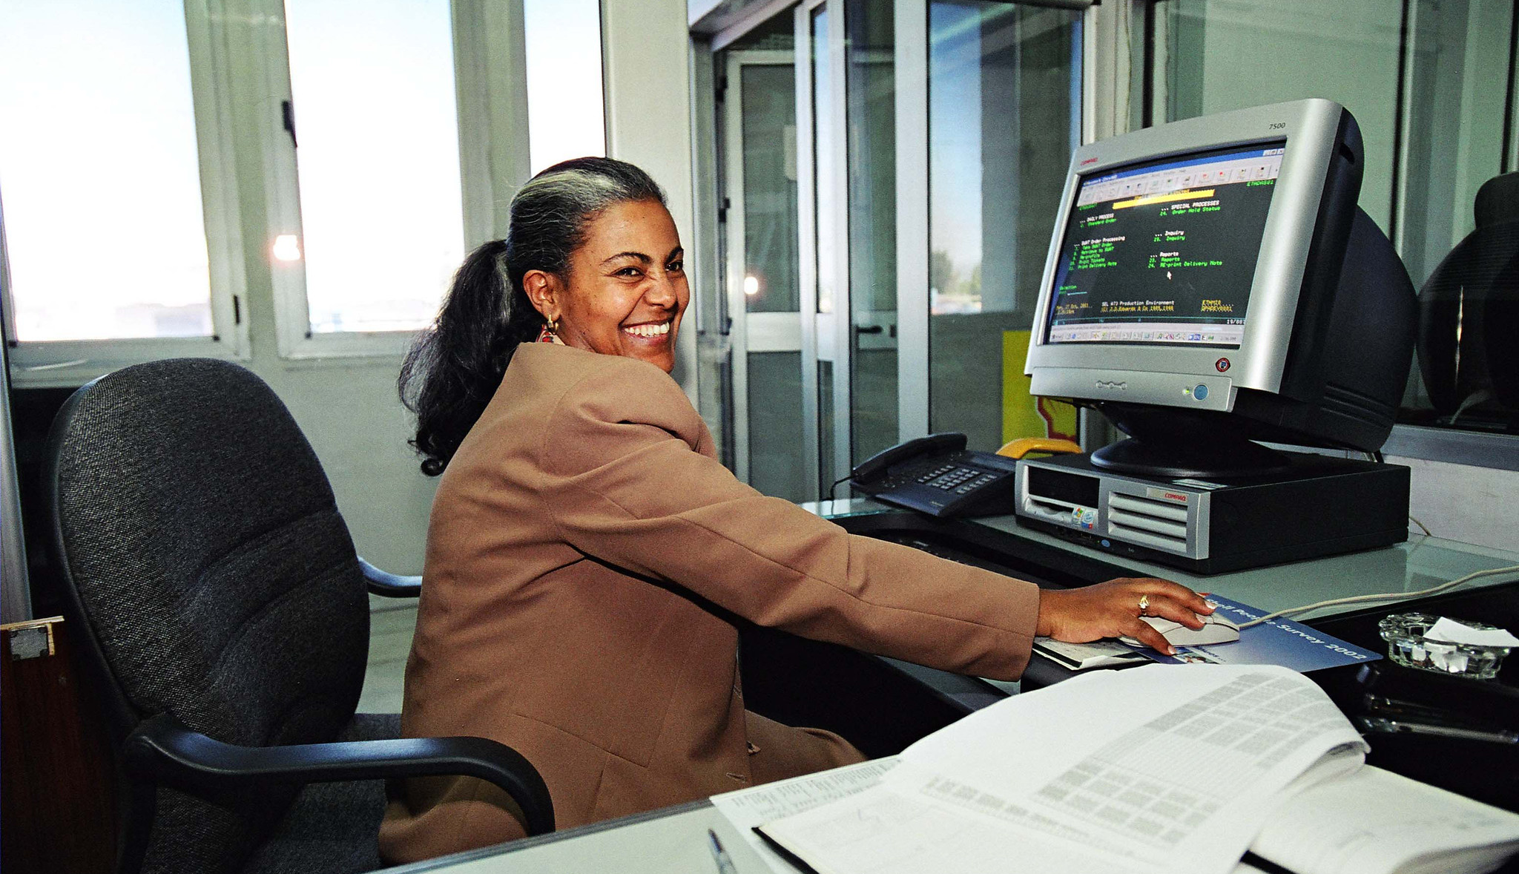
Digitalization, resilience and health insights from the ILO
  Ana Catalina Ramirez
  Technical Specialist on Occupational Safety and Health
  Labour Administration, Labour Inspection and Occupational Safety and Health Branch

Slide 2
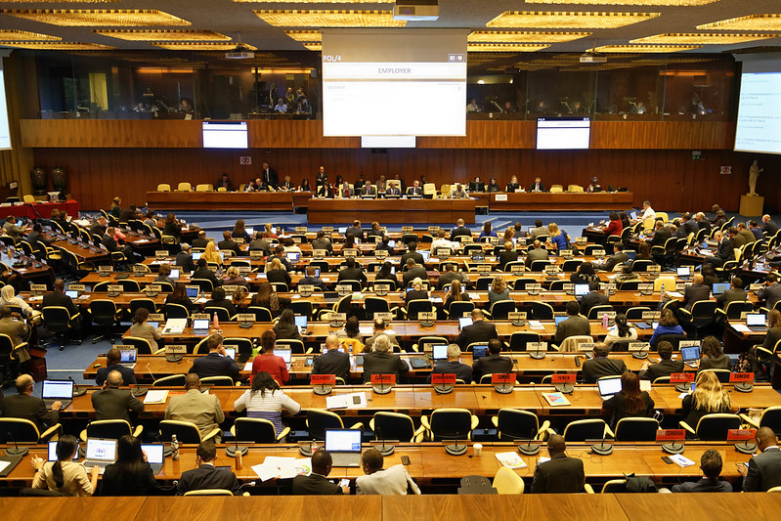
The International Labour Organization
Founded in 1919, the ILO is the first and oldest specialized agency of the United Nations
    Tripartite governance structure including governments (187 member states), workers and employers organizations
    Mission: promote rights at work, encourage decent employment opportunities, enhance social protection and strengthen dialogue on work-related issues
    International Labour Standards: Legally-binding Conventions ratified by member states, Protocols and Recommendations (linked to Conventions)

Slide 3

A safe and healthy working environment is a fundamental principle and right at work
  At its 110th Session in June 2022, the International Labour Conference adopted the Resolution on the inclusion of a safe and healthy working environment in the ILO’s framework of fundamental principles and rights at work
    Amendment of paragraph 2 of the ILO Declaration on Fundamental Principles and Rights at Work (1998) to include “a safe and healthy working environment” as a fundamental principle and right at work
    Occupational Safety and Health Convention, 1981 (No. 155) and the Promotional Framework for Occupational Safety and Health Convention, 2006 (No. 187) considered as fundamental Conventions
    consequential amendments to the ILO Declaration on Social Justice for a Fair Globalization (2008) and the Global Jobs Pact (2009)

Slide 4
Digitalization: occupational safety and health opportunities and challenges
    Remote work and hybrid working arrangements
    The gig and platform economy
    Wearables, monitoring devices and smart technology
    Automation, AI and robotics
Digitalization presents many opportunities to improve safety and health for workers
    For those working remotely, increased flexibility and the ability to work from home
    Automation and use of AI and robotics for hazardous or repetitive tasks
    Wearables and other smart devices can monitor hazards in the working environment
Digitalization also presents many OSH risks, which must be prevented and mitigated

Slide 5
Digitalization, remote work and the physical environment, including ergonomics

Slide 6
Remote Work and the physical environment (including ergonomics)
Home settings often do not meet the same OSH standards as those available at the official worksites, in relation to:
    the physical environment (such as heat, cold, lighting, electrical safety, home hygiene, etc.)
    ergonomics
    facilities and equipment
    internet connection
    Potential Occupational Safety and Health Effects of the Physical Environment and Ergonomics
    Physical health effects:
    musculoskeletal pain and injuries
    eye strain
    fatigue
    other adverse physical effects
  Mental health effects:
    stress, anxiety, burnout
    other mental health effects

Slide 7
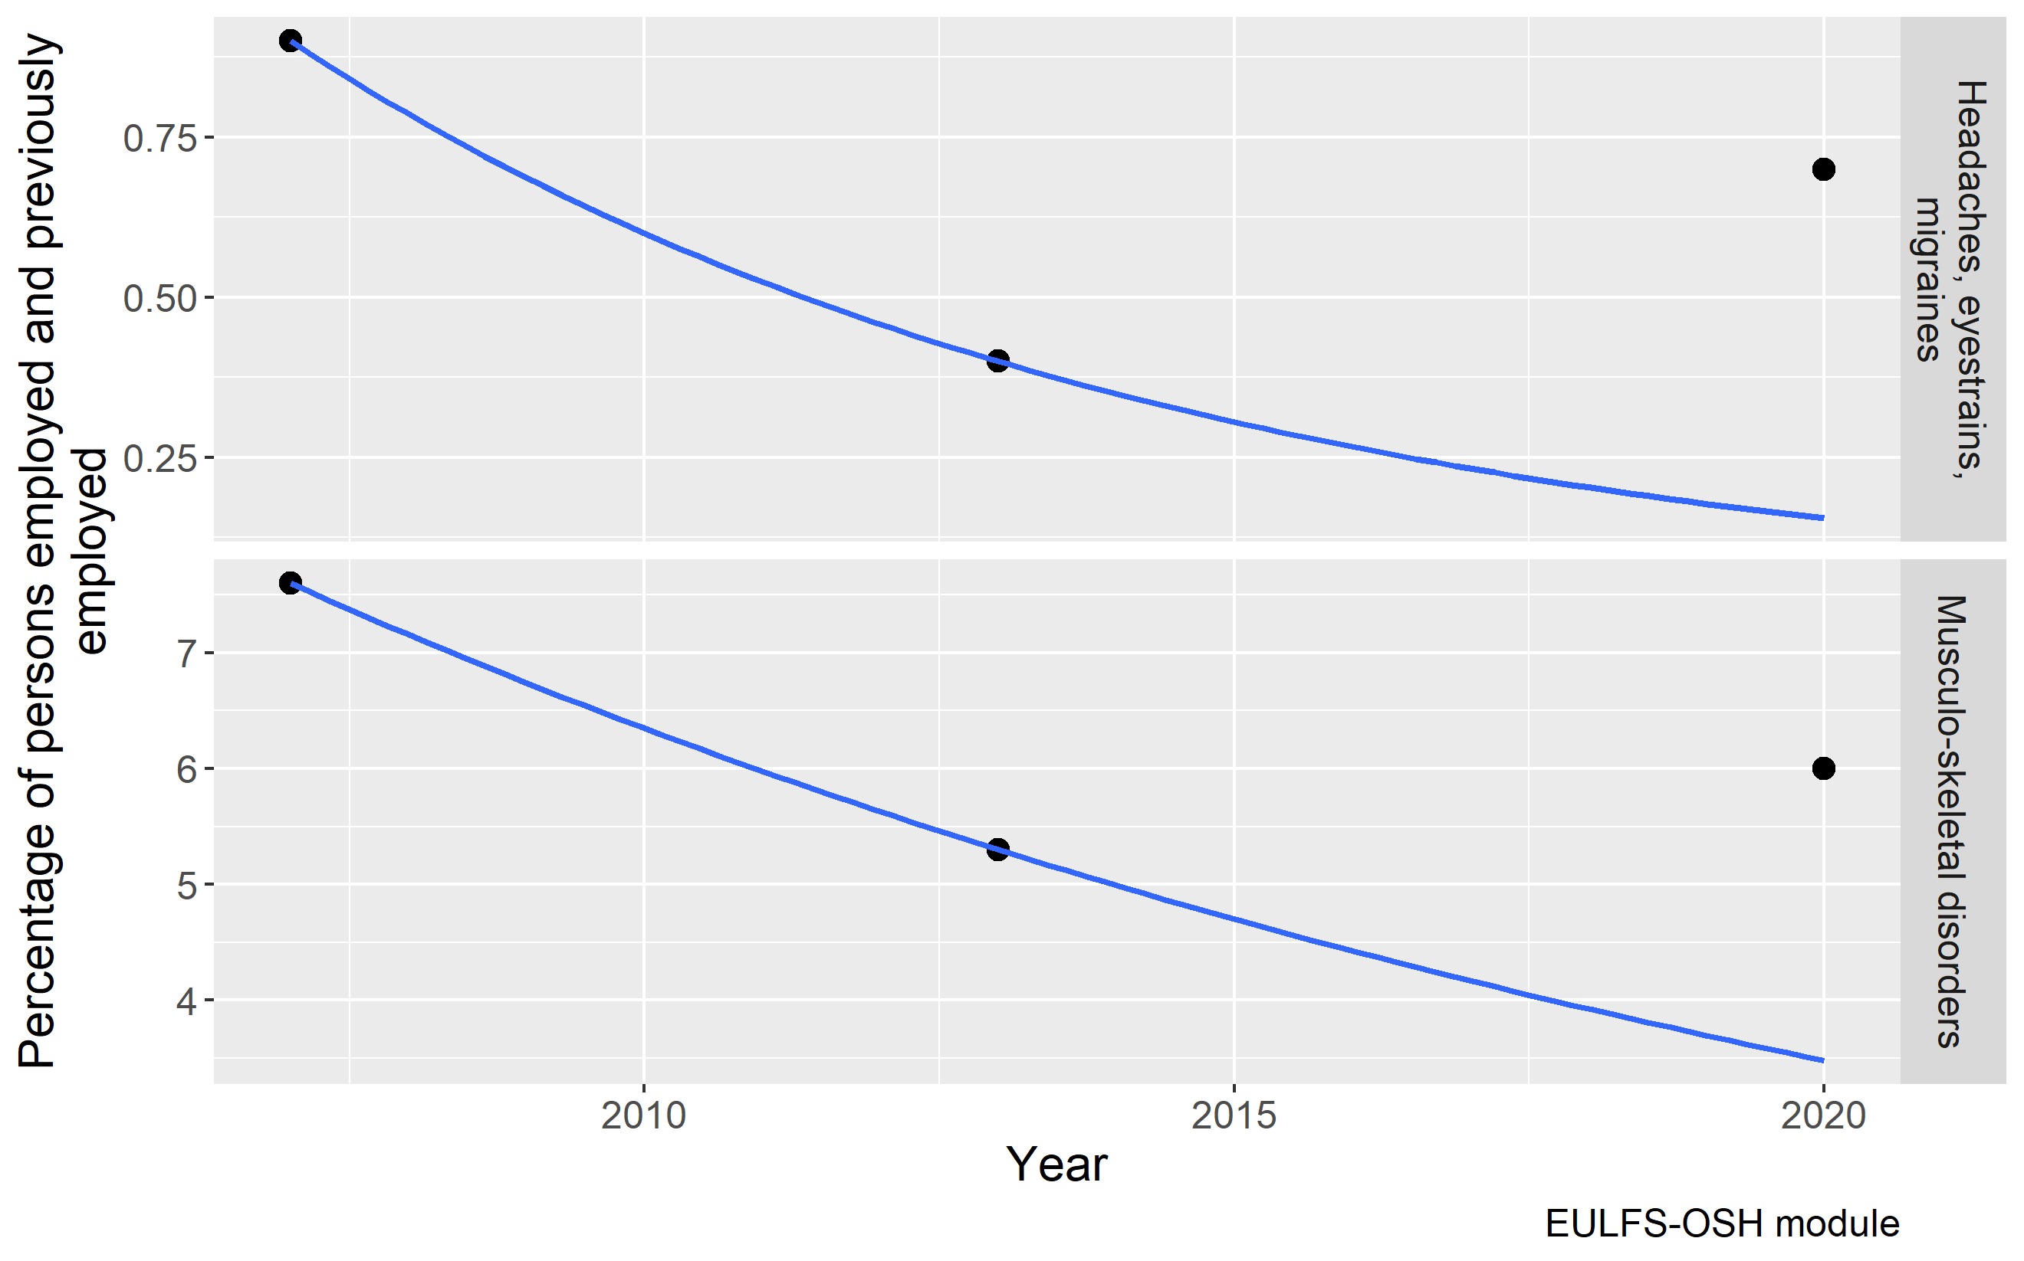
Persons reporting work-related diseases linked to the physical environment, including ergonomics in EU 27
In 2020 the self reported prevalence of work-related Headaches, eyestrains, migraines was about 3.5 times higher compared to forecasted, the prevalence of work-related Musculo-skeletal disorders was about 1.7 times higher compared to forecasted.
Meantime the share of people working from home is doubled from 5-6% to 12% in EU 27.

Slide 8
Improving the physical environment and ergonomic factors during remote work
Suggested Actions
    Employers should provide workers with adequate information on:
    Ways to modify the physical environment to reduce risks
    Reviewing where the screen is located to avoid glare;
    How best to place equipment to minimize twisting or overreaching;
    Varying work tasks to change positions;
    Taking regular breaks and to stand and move for one minute every hour
    Train people working from home in how to work from home safely and effectively
    Adequate equipment should be provided when needed to complete the job tasks

Slide 9
Remote work and psychosocial factors
Including work-pace, work-load and work-schedule; work-life balance; and violence and harassment

Slide 10

Common psychosocial factors when working remotely
    Inadequate information
    Isolation
    Frustration and boredom
    Work-pace, work-load and work-schedule (Long working hours)
    Work-Life Balance, blurring lines between work and family life
    Multiple burdens (working duties, household chores, caretakers, home-schooling, etc.)
    Violence and harassment (including domestic violence)

Slide 11
Impact of psychosocial risks and work-related stress on remote workers
    Psychological responses: low mood, low motivation, exhaustion, anxiety, depression, burnout and suicidal thoughts
    Physical reactions: digestive problems, dermatological reactions, cardio-vascular disease, musculoskeletal disorders, headaches or other unexplained aches and pains
    Increased risk of work injuries and accidents (due to reduced accuracy)
    Impact on workplace productivity: increased absenteeism and presenteeism, lower job engagement and reduced job performance (with respect to both the quality and quantity of work)

Slide 12
Special focus on work-load, work-pace and work-schedule
Risks
    Workers may experience either work overload or underload
    Unrealistic work-pace or deadlines
    Working long hours or late into the night
Impact on OSH
    Stress and burnout
    Physical and mental fatigue
    Increased risk of mental health effects, such as anxiety or depression

Slide 13
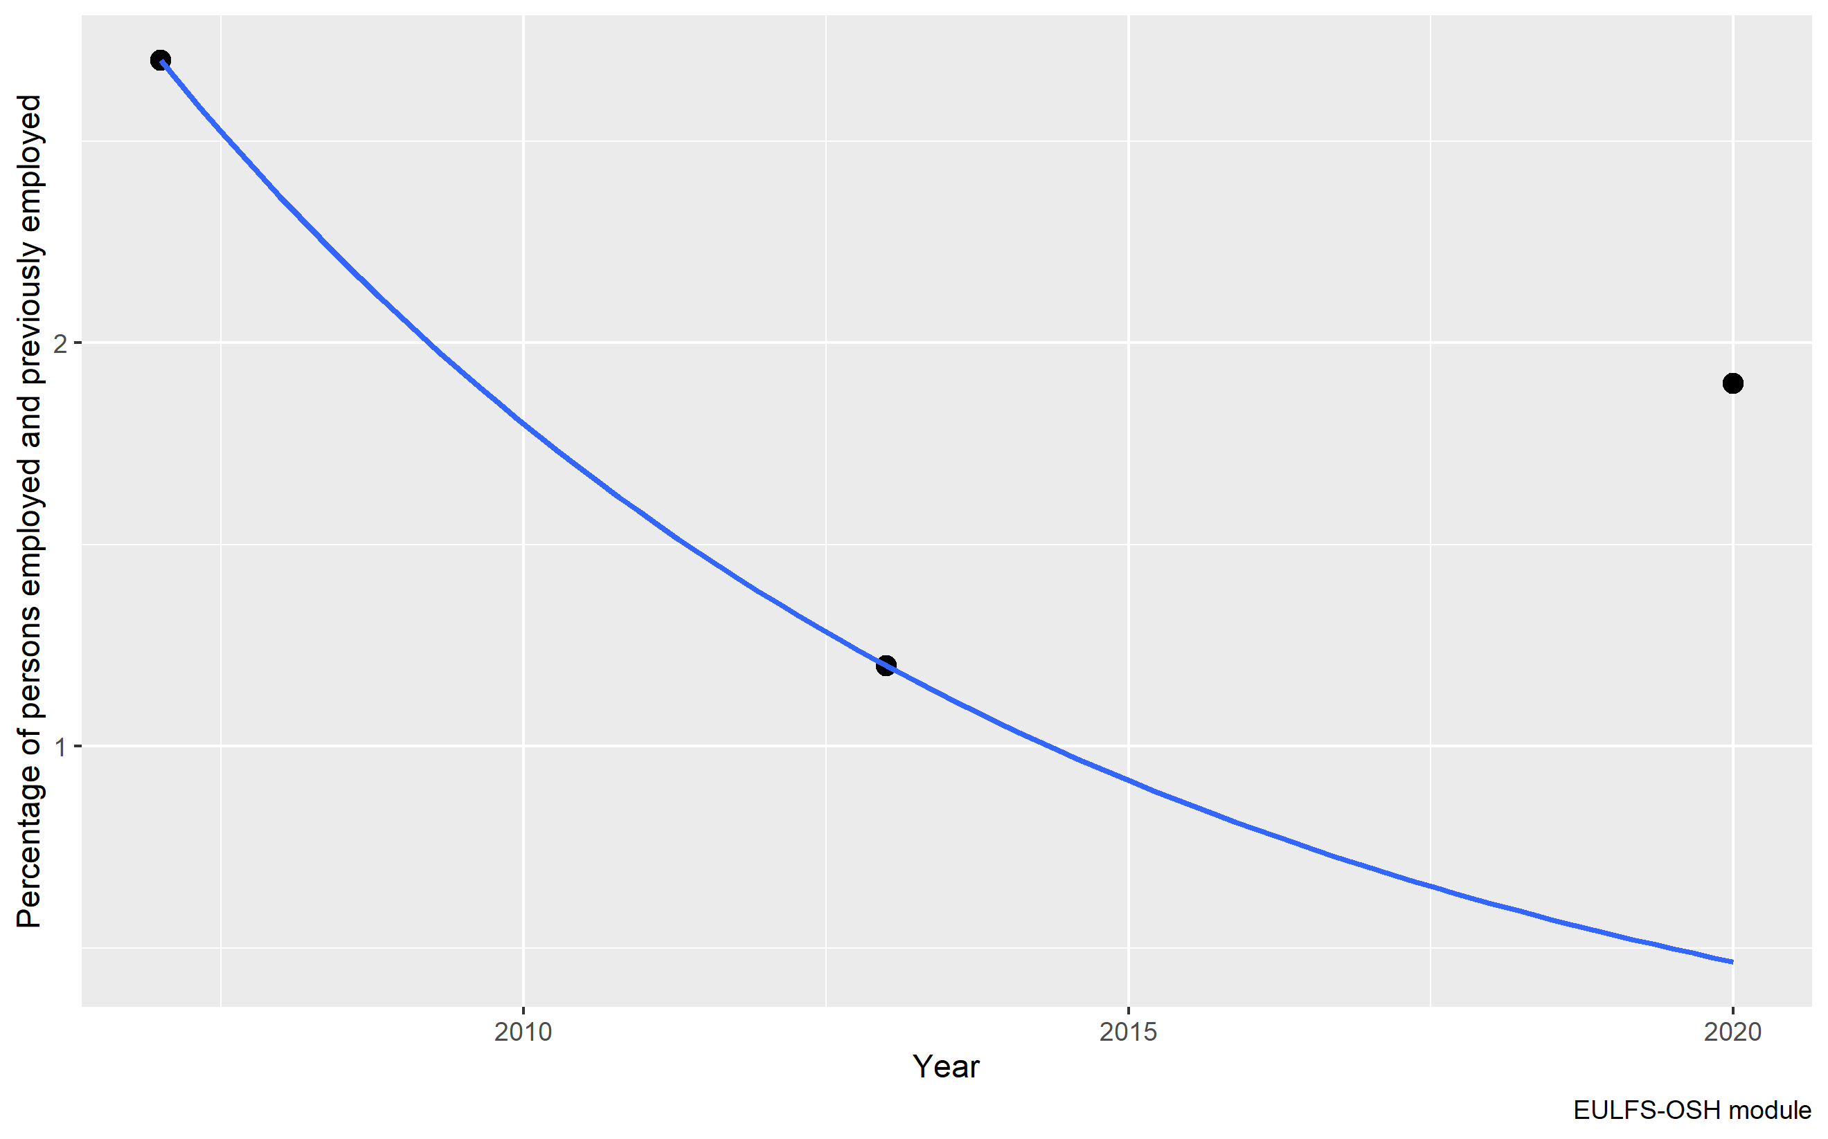
Persons reporting work-related Stress, depression, anxiety in EU 27
In 2020 the self reported prevalence of work-related Stress, depression and anxiety was about 4 times higher compared to forecasted. Meantime the share of people working from home is doubled from 5-6% to 12% in EU 27.

Slide 14
Workload, work-pace and work-schedule and preventing stress
Suggestions Actions
    Management commitment and support and connection with supervisors and colleagues
    Review and clearly define tasks, responsibilities and results to be achieved
    Assess workload and adjust and redistribute work assignments, if needed
    Improve working methods and ensure that the necessary equipment and supports are available to help workers complete their tasks safely and efficiently
    Arrange work schedules with hours of contactability and emphasize the right to disconnect
    Include sufficient breaks and encourage workers to have regular breaks
    Encourage relaxation exercises, stretching or recreational activities during breaks in meetings

Slide 15

Special focus on work-life balance
Blurred boundaries between personal lives and work when working from home
    Working hours and contactability
    Lack of clarity around sick leave and other policies
    Balancing work with family duties, such as young children or family members who may be at home
  Potential Impacts on Occupational Safety and Health
    Increased stress and other psychological effects
    Physical and mental fatigue, burnout
    Negative effects on social health and wellbeing

Slide 16
Work-life balance
Suggested actions
    Increase flexibility in working-time arrangements so workers can meet their increased responsibilities
    Inform workers about sick leave policies
    Allow workers to use annual leave and/or parental leave if needed
    Combine flexibility with ground rules about when workers are or are not available for working in order to allow them to disconnect from work at specified times reserved for rest and personal life
    Promote a focus on the quality of work rather than quantity
    Advise workers about creating a dedicated workspace free from disruptions and establishing boundaries around their working hours with their partners, children and/or house mates

Slide 17
Special focus on violence and harassment
Risks
    Cyberbullying, between colleagues or from the public, clients, etc.
    Domestic violence, due to spending more time in close contact with violent family members
Suggested Actions
    Develop a workplace policy and ensure all staff are aware of it and abide by it
    Regularly consult with workers and their representatives to see if violence and harassment is occurring
    Provide workers with clear instructions on how to effectively defuse hostile situations
    Establish procedures to prohibit discrimination and harassment and promote fair treatment of workers
    Raise awareness about the effects of domestic violence, available resources and support for victims

Slide 18
Remote work, management leadership and communication

Slide 19

Remote work: Management leadership and communication
    Communication is limited through primarily information technology channels as opposed to face-to-face communication
Potential impacts of poor communication
    Reduced productivity, resulting in stress, frustration or burnout
    Difficulty understanding the task at hand, resulting in stress
    A lack of understanding about OSH rights and responsibilities
    Impacts on social health, due to decreased communication with colleagues and management

Slide 20
Communication, information and training
Suggested actions
    Create an environment of open, honest and effective communication
    Engage in dialogue with workers about their concerns and needs
    Train managers and supervisors to act as role models
    Train managers and supervisors in how to recognize signs of depression and stress disorder and detect violence and harassment
    Teach calming skills and maintenance of natural body rhythms (for example, nutrition, sleep, rest and exercise)
    Educate managers about best practices for dealing with remote workers, so they are better able to mentor and support their teams
    Respect workers’ privacy

Slide 21
Remote Work and Health Promotion

Slide 22
Health promotion and prevention of negative coping behaviours
  Working from home can bring profound changes to normal routines, increasing the risk of some unhealthy behaviours, which may affect both physical and mental health and have a negative impact on job performance.
  Psychosocial risks and work-related stress are associated with unhealthy behaviours, including
    heavy alcohol consumption
    increased cigarette smoking
    poor eating habits
    less frequent physical exercise
    irregular sleep patterns

Slide 23
Remote Work: Health promotion and prevention of negative coping behaviours
Suggested actions
    Revise working-time arrangements to improve sleep, rest and reduce fatigue
    Inform and educate workers about healthy routines for sleep
    Encourage regular exercise, including by providing information on how to exercise at home
    Encourage healthy habits such as regular breaks, not missing meals and making informed food choices
    Provide training and resources on alcohol and drugs and services available
    Train managers and supervisors to identify changes in job performance and behaviour that may indicate potential substance abuse, so they can refer them to support services

Slide 24
ILO Resources
    Mental Health at Work: WHO/ILO Joint Policy Brief (2022)
    Healthy and Safe Telework (April 2022)
    Working from home: From invisibility to decent work (January 2021)
    Practical Guide on Teleworking during the COVID-19 pandemic and beyond (July 2020)
    Safe and healthy working environments free from violence and harassment (July 2020)
    Managing work-related psychosocial risks during the COVID-19 pandemic (June 2020)
    Work from home: Human factors/ergonomics considerations for teleworking (April 2020)
    In the face of a pandemic: Ensuring Safety and Health at Work (April 2020)
    Safety and Health at the Heart of the Future of Work (April 2019)
    The essential contribution of Human Factors/Ergonomics to the future of work we want (March 2019)
    The SOLVE training package: Integrating health promotion into workplace OSH policies (April 2012)
    Guidelines on occupational safety and health management systems – ILO-OSH 2001 (2009)
    ILO ergonomic checkpoints app (July 2010)

Slide 25
Thank you! acramirez@ilo.org

