Slide 1

Guide for good practices for professionals and managers. Shaping Digitalisation and ensuring employees’ rights
Dr. Nicole Helmerich,
expert to the digitization project of Eurocadres, author of the guide
Presentation at the conference: Digitalisation on the EU agenda: What is the impact in the workplace? 20 – 21 October 2022, Paris

Slide 2
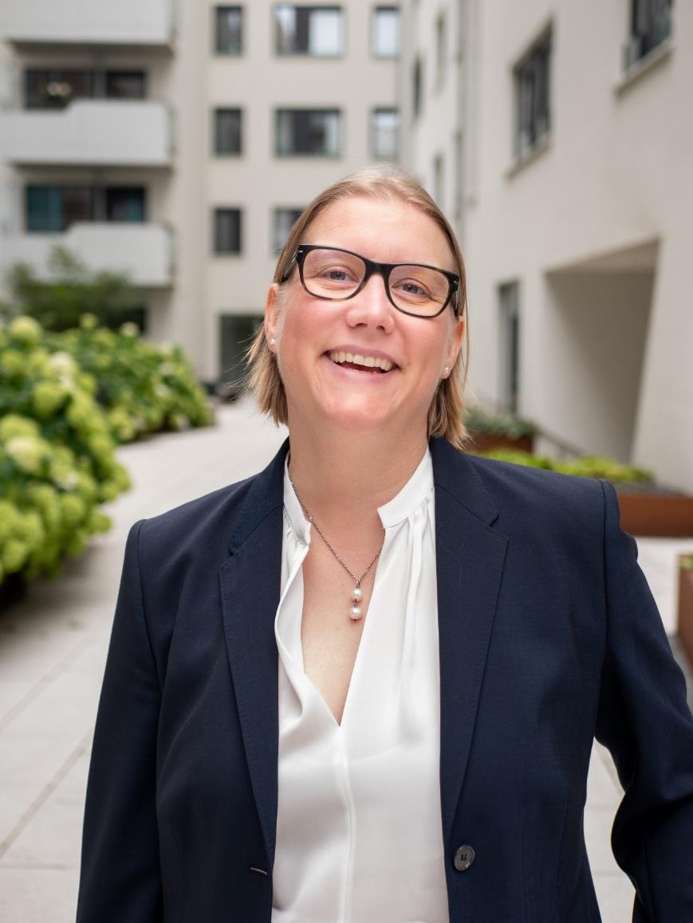
About me
Dr. Nicole Helmerich
Digitalization expert
Organizational developer
(Focus: New Work)
Trainer/Facilitator
Sustainability consultant
Coach with focus on resilience and
Burnout-prevention
✉️ info@nicole-helmerich.com
🔗 linkedin.com/in/dr-nicole-Helmerich
🔗 https://linktr.ee/nicolehelmerich
💻 www.nicole-helmerich.com

Slide 3
Project overview
Title: Social partners’ framework agreement on digitalisation: Better implementation and improved capacity for trade unions of professionals and managers
          4 workshops
            1) June 2021: Social partner negotiations on digital skills
            2) December 2021: The right to disconnect
            3) May 2022: AI and surveillance at the workplace
            4) Sept 29-30, 2022: digitalisation and leadership impact
            Conference
          October 20-21, 2022: Final conference: Digitalisation on the EU agenda: What is the impact in the workplace?
          Publication: Guide for good practices
          October 2022: Guide for good practices for professionals and managers. SHAPING DIGITALISATION AND ENSURING EMPLOYEES’ RIGHTS

Slide 4
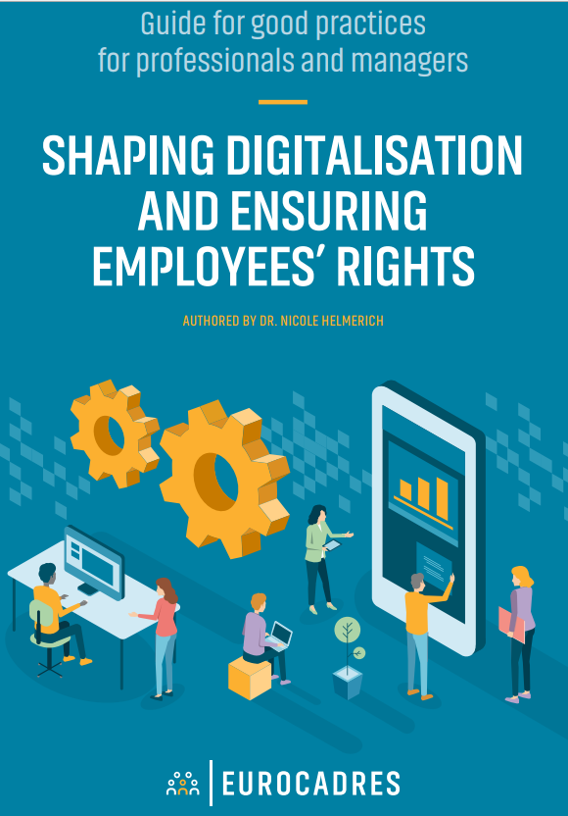
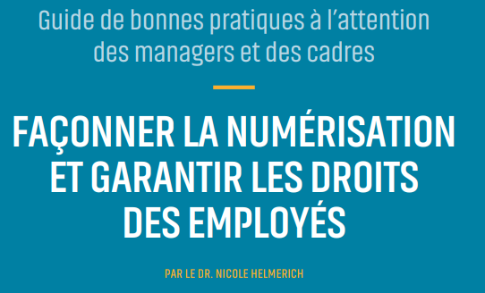
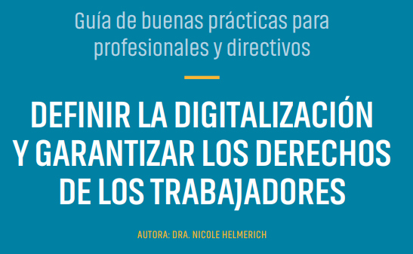
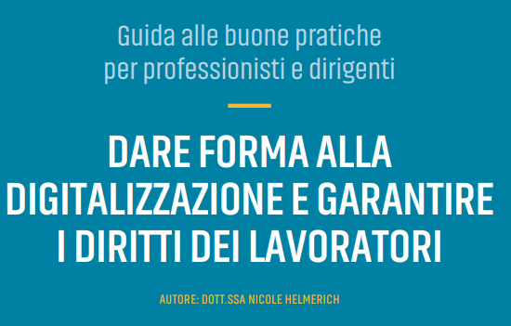
https://www.eurocadres.eu/publications/best-practice-guide-shaping-digitalisation-and-ensuring-employees-rights/
Notes:
Guide is out now. English, French, Spanish and Italian
Target group of the guide: P&MS and unions
I share link here

Slide 5
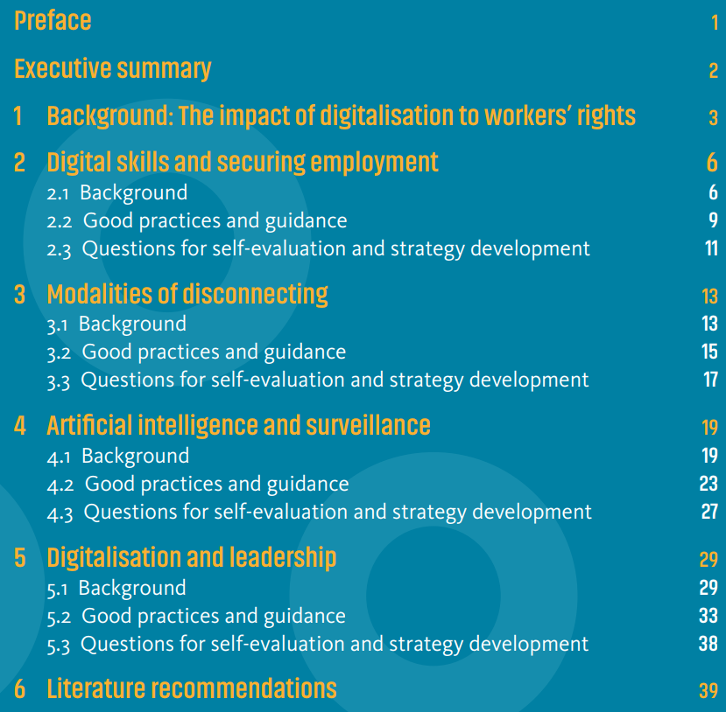
Content of the guide

Slide 6
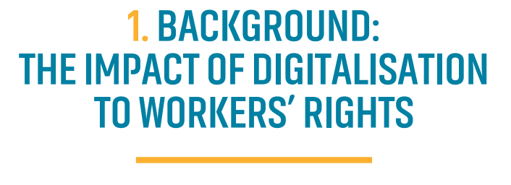
VUCA: Volatility, Uncertainty, Complexity, Ambiguity
We have moved from data-poor but fairly predictable to data-rich but
uncertain
The digital transformation profoundly impacts the way professionals
and managers work. Unions need to support professionals and
managers in this transformation, which is not only a digitalization
of organizations but an inherent changing in jobs, leadership, work, and work organization.
Unpredictability of the world has happened not in spite of technological progress but in part because of it
Notes:
To build resilience we must build organizations that can reconfigure and adapt in reposonse to change or damage (like acoral reaf instead of a pyramid)
Grahammann.net on Stanley McChristal
Complex systems: number of interactions inreases dramatically , dense interactions in complex systems exhibit non linear change, volatile, uncertainty, ambuiguity
Unpredictablity of the world has happened not in spite of technological progress but because of it

Slide 7
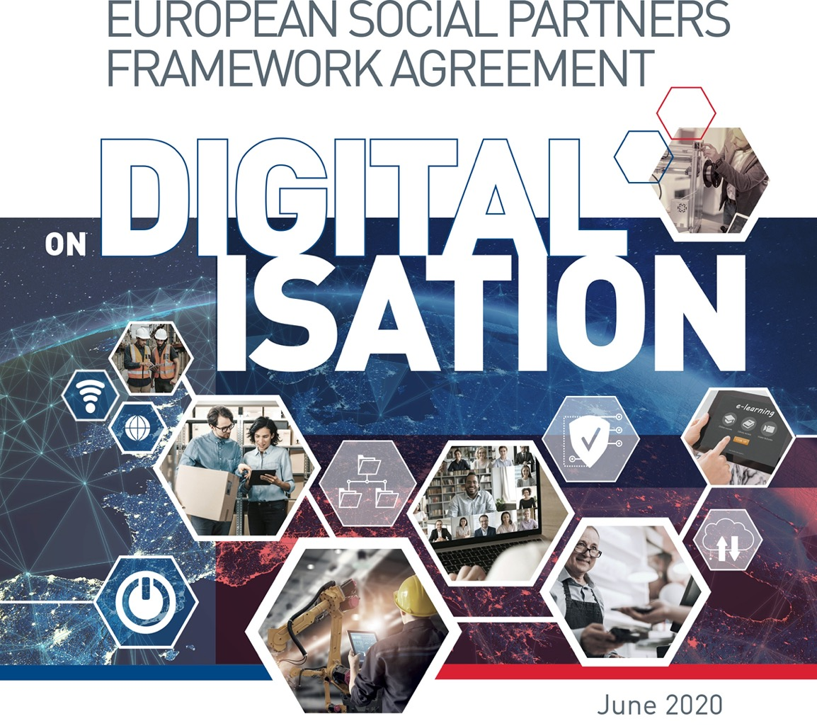

Slide 8
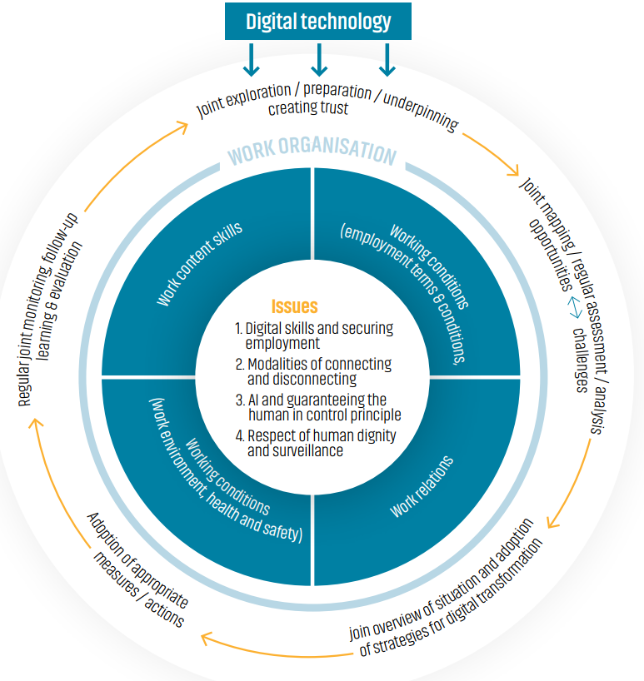
European Social Partners Framework Agreement on Digitalisation
Digitalisation Partnership Process:
The outer circle of figure 1 displays the five stages of the digitalisation partnership process as a joint dynamic circular process between employers and union representa- tives.
The agreement provides step by step guidance on how to design each of the five stages of such a process. These stages within can help create trust, improve commu- nication, and structure the exchange and negotiations between employers and employees. The blue boxes entail the four areas of work organisation impacted by digitalisation.

Slide 9

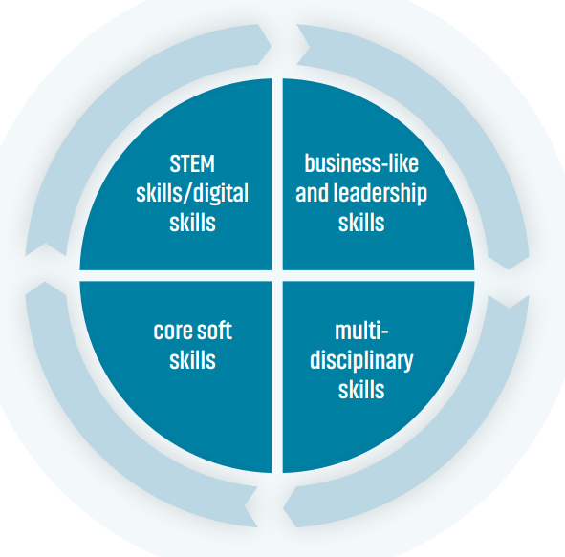
STEM skills/digital skills are technology, engineering and mathematics and the ability to use digital technology at work.
Business-like and leadership skills are project management skills, commerce skills, marketing skills, skills of vocational training type.
Multi- disciplinary skills are abilities that can facilitate the process to find solutions to complex problems from several perspectives.
Core soft skills are employability skills, applicable across different occupations and sectors, teamwork, initiative, creativity, critical thinking, problem solving, communication, and resilience
Olga Strietska-Ilina, ILO Senior Skills and Employability Specialist ILO 2018
Notes:
Re-and upskilling in digital skills is not enough! Need to consider future skills such as
Source: Olga Strietska-Ilina, ILO Senior Skills and Employability Specialist,( ILO 2018): Global challenges impacting the future world of work: What skills will the jobs of tomorrow require?, https://www.youtube.com/watch?v=rBzr_mRPzFI . STEM skills/digital skills are technology, engineering and mathematics and the ability to use digital technology at work. Business-like and leadership skills are project management skills, commerce skills, marketing skills, skills of vocational training type. Multi- disciplinary skills are abilities that can facilitate the process to find solutions to complex problems from several perspectives. Core soft skills are employability skills, applicable across different occupations and sectors, teamwork, initiative, creativity, critical thinking, problem solving, communication, and resilience

Slide 10
RE- AND UPSKILLING: When old jobs disappear, new jobs emerge, and existing jobs change significantly in content. Skill training forms an important part of the larger endeavor of re/up-skilling employees given this change in landscape. The re/up-skilling of professionals and man- agers and all other employees thus becomes an integral part of organizational transformation
LIFELONG LEARNING: P&Ms need the ability to adapt to new circumstances, learn how to use new digital tools, how to work alongside automated systems and systems using artificial intelligence, and how to lead their employees within these new ways of working. They not only need to learn about new technologies, but also to develop a mindset of transformation and a strong ethical posture of leading employees through constantly changing circumstances.
NEGOTIATE QUALITY, TIME, MONEY AND THE RIGHT TO LEARN: Unions need to support professionals and managers in negotiating and implementing agreements on re/up-skilling across companies and sectors.

Slide 11
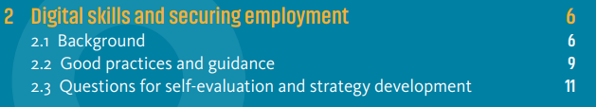
If you would like to know more about digital skills and securing employment turn the guide:
Securing employment through re- ad upskilling
Transformation and lifelong learning
Good practices such as skills compass and sectoral training funds
Questions for self-evaluation and strategy development for P&MS and for unions

Slide 12
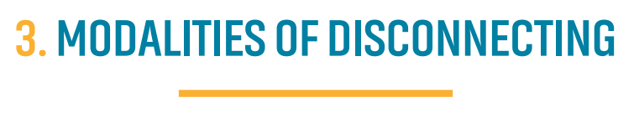
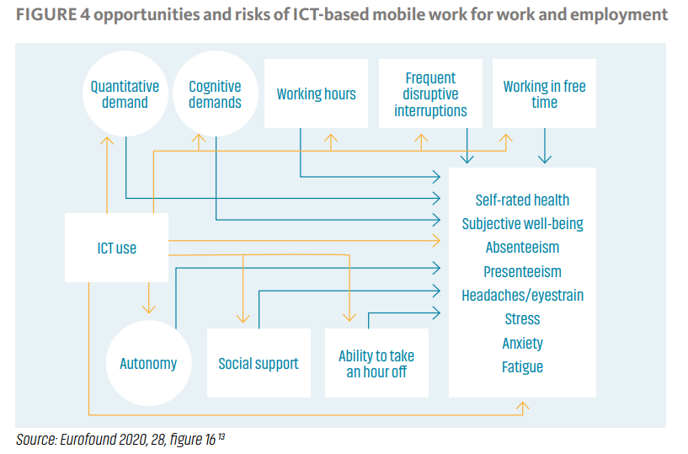

Slide 13
During the COVID-19 pandemic, remote work and mobile work has
increased dramatically. It is here to stay.
Profound change in how we work: hybrid work, a mix of working from home,
mobile work and working at the office and at productions sites of
companies. This hybrid work form is here to stay post-pandemic.
Hybrid work and digitalization opportunities: improved work-live balance,
flexibility and autonomy, improved communication, and collaboration
Hybrid work and digitalization challenges: with poor work organization it
can also create risks such as advanced monitoring and control, increased work intensity and stress, “limitless work”, potential expectation on 24/7 availability, long working hours, limited rest time, and information overload

Slide 14
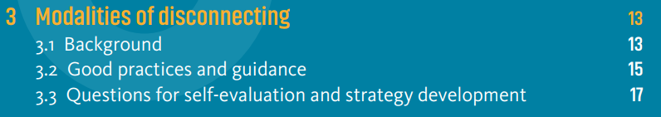
If you would like to know more about modalities of disconnecting turn the guide:
Strategy building on the right to disconnect
Psychosocial risks, resilience and monitoring of working time
Agreements and legislation
Questions for self-evaluation and strategy development for P&MS and for unions

Slide 15
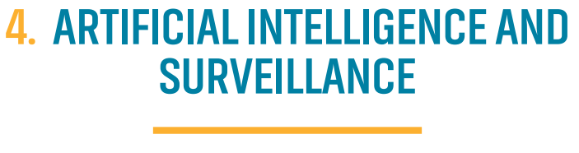
Digital transformation and especially automation and artificial intelligence
need to be actively managed, The later needs to be regulated.
AI systems, automation and digital technology: may help to improve issues of health and safety and enterprise efficiency. Hybrid work may allow employees to integrate private life with work. Digital technology may reduce stress, and
help allocate work within a team better while automation may reduce
dangerous or repetitive work tasks and protect employees from accidents and fatigue
Technology may be used to control and monitor every step of work. Tech-
nology designed for control and work efficiency increases stress and work
intensity. This may have a negative impact on mental and physical health,
compromise human dignity, deteriorate working conditions and the well-being of employees.

Slide 16
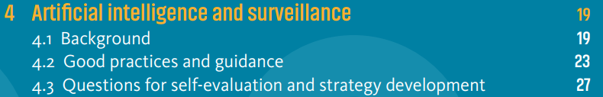
Opportunities and challenges concerning automation and
artificial intelligence
The human in control principle
General Data Protection Regulation (GDPR) to claim digital rights and data rights
Good practices and guidance: step by step: claim your digital rights and
checking data privacy in digital systems, data protection impact assessment
(DPIA)
Good case examples
Questions for self-evaluation and strategy development

Slide 17

Digital transformation is here to stay, leading into organizational
transformation, change and restructuring that is regular rather than exceptional. Consequently, professionals and managers’ role and the demand for leadership
from colleagues changes profoundly.
Project based work, cross-departmental projects, temporarily formed
interdisciplinary teams, agile work forms change leadership demands
New communication channels changes information asymmetry between
hierarchical communication organization
Hybrid work change leadership demands
New leadership skills need to be embedded in a cultural transformation
Training professionals and managers in skills is not sufficient to respond to new leadership demands.
A transformation towards leading people instead of task management only works if senior management actively creates a company structure and company culture and commits to supporting professionals and mangers during this transformation.

Slide 18
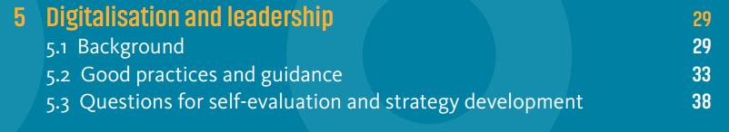
Introduction to new leadership types and the need for a change in organizational structure
Without changing the organization culture digital transformation will fail
Good practices and guidance: for P&MS and for unions
Questions for self-evaluation and strategy development

Slide 19
Literature and useful links 1
Digitalization
Böhm, Stephan Alexander et. al. (2022) social health @work. Zweite Berichterweiterung 2022 Ursachen und Wirkungen im Zeitverlauf, https://www.barmer.de/resource/blob/1032252/b29c775dab99ec838e74f90f4a00e798/social-health-work-studienbericht3-data.pdf#1081764. In German only!
Eurofound (2021) The digital age: Automation, digitisation and platforms, https://www.eurofound.europa.eu/data/digitalisation
Eurofound (2020), Telework and ICT-based mobile work: Flexible working in the digital age, new forms of employment series, Publications Office of the European Union, Luxembourg
Ponce Del Castillo, Aida (2020): Labour in the age of AI: why regulation is needed to protect workers, ETUI Foresight Brief, #08 – February 2020.
Developing Culture
Kegan, Robert/Lahey Laskow, Lisa (2016) An Everyone Culture: Becoming a Deliberately Developmental Organization . Harvard Business Review Press.

Slide 20
Literature and useful links 2
New Leadership forms and new organization
Aaron Dignan (2019) Brave New Work.
Allen, S.J. (2020). On the cutting edge or the chopping block? Fostering a digital mindset and tech literacy in business management education. Journal of Management Education, 44, 362–393.
General Stanley McChrystal, David Silverman, Tantum Collins, Chris Fussell (2015) Team of Teams. New Rules of Engagement for a Complex World.
Sharon George, January 25, 2018 Insights / Information Technology / Article, https://www.gartner.com/smarterwithgartner/3-characteristics-of-the-new-digital-leader-mindset
Gilli , K., Nippa, M., & Knappstein, M. (2022). Leadership competencies for digital transformation: An exploratory content analysis of job advertisements. German Journal of Human Resource Management, 0(0). https://doi.org/10.1177/23970022221087252
Judith Muster (2021) Wie lässt sich Führung entwickeln? (How can we develop leadship. Podcast in German) https://lea-podcast.podigee.io/51-fuhrung-entwickeln
Jennifer Juo, Soft Skills: 4 Key Leadership Skills to Drive Your Digital Transformation, March 2020, https://blog.udemy.com/4-key-leadership-skills-to-drive-your-digital-transformation/
Solving complex problems
Rancati, Alessandro; Snowden, Dave (2021) Managing complexity (and chaos) in times of crisis. A field guide for decision makers inspired by the Cynefin framework, Luxembourg: Publications Office of the European Union.
Snowden Dave; Mary E. Boone (2007) A Leader’s Framework for Decision Making, Harvard Business Review.

Slide 21
Literature and useful links 3
Skills
Olga Strietska-Ilina, ILO Senior Skills and Employability Specialist ( ILO 2018): Global
challenges impacting the future world of work: What skills will the jobs of tomorrow
require?, https://www.youtube.com/watch?v=rBzr_mRPzFI

Slide 22

Dr. Nicole Helmerich
✉️ info@nicole-helmerich.com
🔗 linkedin.com/in/dr-nicole-helmerich
💻 www.nicole-helmerich.com
Lizenzfreies Foto: Gratisography https://www.pexels.com/de-de/foto/licht-schild-typografie-beleuchtung-519/

