Slide 1
Social Partner Agreement on digitalisation
Eurocadres conference, 20-21 October 2022, Paris
Digitalisation on the EU agenda: What is the impact in the workplace?
As part of the EU project: Social partners’ framework agreement on digitalisation

Slide 2
Digitalisation agreement : background
Social dialogue Committee for central government administrations – SD CCGA
Established in 2010 by the European Commission at the request of the social partners
18 governments on the employers side, EUPAE, and all EU MS on the trade union side, TUNED led by EPSU
Sector employs about 9 million employees in the EU
Second agreement adopted by the SDC CGA in line with Article 155.2 TFEU that provides for legislative implementation via a directive for Council adoption – colegislative role of social partners
First (failed) one on consultation rights on restructuring (2015) rejected by the Commission which led to a court case by EPSU

Slide 3
Background and objectives
Possibility of an agreement goes back to a project on work/life balance and digitalisation, 2018-2019
COVID pandemic and generalisation of teleworking confirmed the need for an agreement
Exploratory talks started in 2020 taking into account cross-sector agreement on digitalisation
Online negotiations funded by the Commission January 2021-2022
Negotiated with a view to becoming legally binding (reiterates some legal requirements and adds new ones)
How to shape and reclaim digitalisation, in all its forms, for the interest of employees and quality of administration ?
Leverage for new trade union rights to organise and bargain
Application to all civil servants and public employees
Adoption on 17 June and signature on 6 October

Slide 4
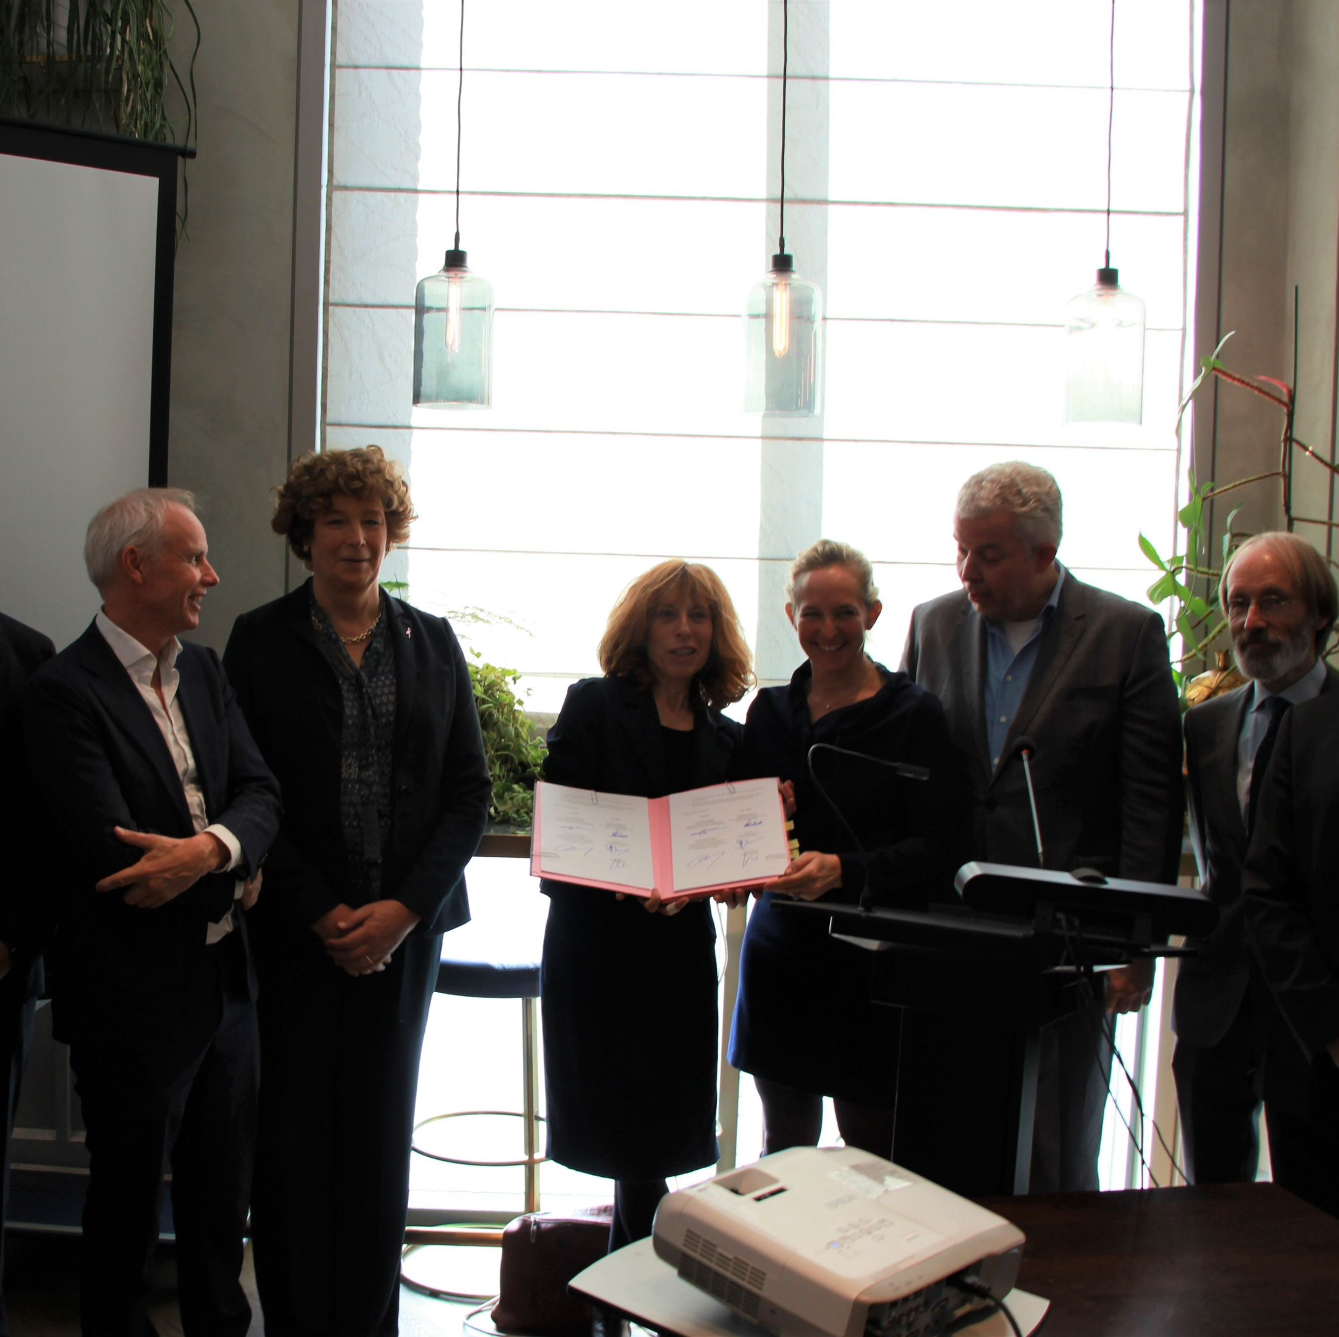
Agreement signed on 6 October
civil service ministers from Belgium and France
EPSU
CESI
TUNED spokesperson

Slide 5
Broad agreement: Table of contents
Definitions
Telework
Health and safety
Skills development, training and qualifications
Data management and protection
Artificial intelligence
Access for users
Additional clauses: Outsourcing, job protection and agile work
Implementation and non regression clause

Slide 6
Telework
Builds upon 2002 cross-sector telework agreement
Right to request to telework, voluntary, reversible, limited (No of days or working hours by national collective bargaining)
Administration facilitates communication with trade unions
Equal treatment clause
no negative impact if worker refuses to telework
right to disconnect must be agreed with trade unions (possible derogations)
Equipment provided by the administration
compensation for additional work-related expenses left to national collective bargaining
transparent management, workload based on trust and regular communication
Users’ right to contact and speak with a relevant official, on or offline, that deals with their file.

Slide 7
Health and safety
Digitalisation can enhance autonomy, flexibility, work/life balance, attract or retain employees with disabilities
It also brings mental, cognitive and physical health risks due to intensification, excessive working hours, overtime, psychosocial risks
digitalisation introduced or deepened only if there are no negative health and safety issues for workers based on risk assessments.
Health risk assessments in consultation of trade unions must include staffing levels, workload, domestic violence
Teleworkers must have ergonomically fit equipment
Sufficient facility time provided to workers and trade union representatives to attend trade union health and safety training on digitalisation.

Slide 8
training
essential for successful digitalisation and personal development.
Must be during working time, paid for by the employer
Quantitative training budget targets based on a prior evaluation of training needs carried out in consultation of workers’ representatives.
Must benefit all workers in line with EU equality/anti-discrimination directives
specific additional support where needed
Focused training to help managers in adapting their skills to digitalisation.

Slide 9
Data management and protection
Must be subject to law or collective agreements, in line with GDPR
Workers’ control over their personal data
Workers cannot be subject to a decision based solely on automated processing including profiling
They can access easily information about the decisions made by automated means with a right to redress and effective remedies.
collection of data only for a concrete and transparent purpose, not for a possible future undefined purpose
Mutual trust as guiding principle - staff control procedures for security reasons concerning data management and protection are only allowed if defined and agreed with the unions.
Monitoring the performance of employees must be transparent as set by law and collective agreements.
Ban on measuring employees' emotions or instruct employees how to feel.

Slide 10
Artificial intelligence
A tool to serve the common good, improve quality of working conditions and public services and support meaningful work.
Respect of GDPR
Workers’ reps closely involved before introduction or deepening of AI systems
cannot replace experience of humans and social and emotional intelligence.
a "human-in-command" and “human-controlled” approach
option of not accepting a given type of AI at all is always kept open.
the administration has access to the source code of algorithms.
Assessment with trade unions of safety and inclusiveness of AI
Ban on discrimination against trade union membership and fundamental trade unions rights.
Job impact assessments in consultation with trade unions, to assess at an early stage whether and which activities will be replaced, and prepare impacted employees.
requalification in case of jobs threatened by AI.
Ethical guidelines are elaborated in close consultation of workers and their representatives, addressed to developers, programmers, decision-makers and employees involved in AI systems.

Slide 11
Access for users
Quality of users’ access to the administration is guaranteed
Combination of physical and online services
Possibility for the user to have a personal contact (digitalized or in presence)
Protection of users’ data in terms of their rights to information, access, erasure, restriction of processing, data portability, to object and to avoid automated decisions

Slide 12
Additional clauses: - outsourcing - job protection
outsourcing of digitalisation must be strategically/technically justified, strictly monitored.
Alternatives carefully thought out.
Developing own staff skills to avoid relying on private providers.
Public contracts are transparent and accessible to all, respect collective agreements.
Job losses as last resort measure after reduced working hours and support for transition with another employer and in all events is subject to severance payment
impact assessment carried out on a regular basis in close consultation of the trade unions.
workers and their trade union representatives consulted in good time regarding the consequences of the introduction or deepening of digital tools so that trust in the process can be built

Slide 13
Implementation
Trade union wins e.g. on right to consultation or collective bargaining on telework, right to disconnect, OSH risk assessments (including domestic violence), AI, outsourcing and public investment in own staff IT skills
Trade unions’ digital access to members and potential members
request for the agreement to be implementated by a directive sent to the Commission on 6 October
Commission’s full discretion to decide- ongoing social dialogue review
Link with cross-sector negotiations on telework and right to disconnect
Responds to Commission’s pledges to social partners to strike more agreements
Already positive impact e.g. Spanish legislation

