Slide 1

Valued at work

Slide 2

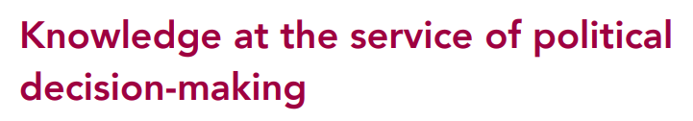
About us

Slide 3

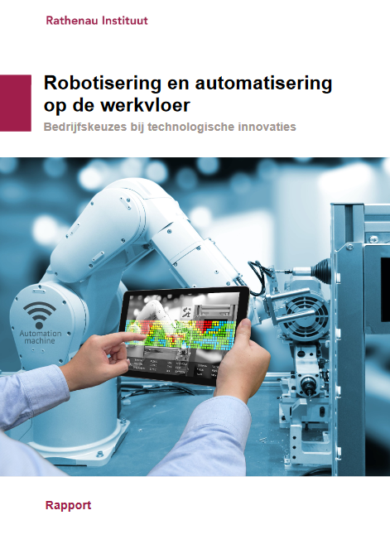

Labour and technology

Slide 4
Algorithmic management
The use of data and algorithms to carry out traditional management tasks
Often researched as a feature of the platform economy
..but practices of algorithmic management can also be seen in standard jobs and traditional organisations

Slide 5

The datafied workplace
We work more digital than ever
Digital tools help us do our work..
..but can also be used to gather information about workers
Digital ‘footprint’ = everything is traceable and can be measured

Slide 6
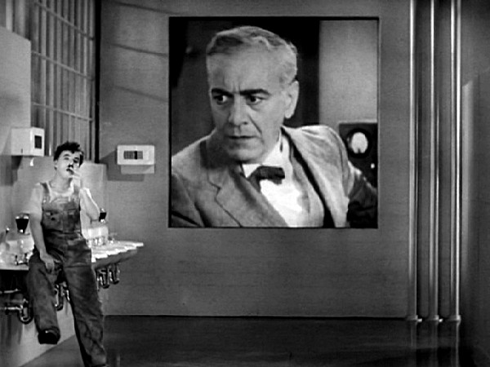
Not a new phenomenon
Monitoring in itself is nothing new
Technological developments always come with new opportunities for ‘controlling’ workers
Throughout history, this led to various excesses, giving rise to distressing social conditions for workers.
Raises debate about what is desirable

Slide 7

‘How’ is not predetermined
The way in which we use technology in the workplace is not just dependent of what technology can do
Efforts of governments, trade unions and other parties resulted in greater protection for workers
Strike a balance between organisational and worker interests, and between what was technically possible and socially desirable.

Slide 8

Today’s monitoring
Digital tools for tracking, analysing and providing feedback or instructions to workers
The tools are ubiquitous
It’s all about data; what can be measured?
The value of work becomes ‘quantified’

Slide 9
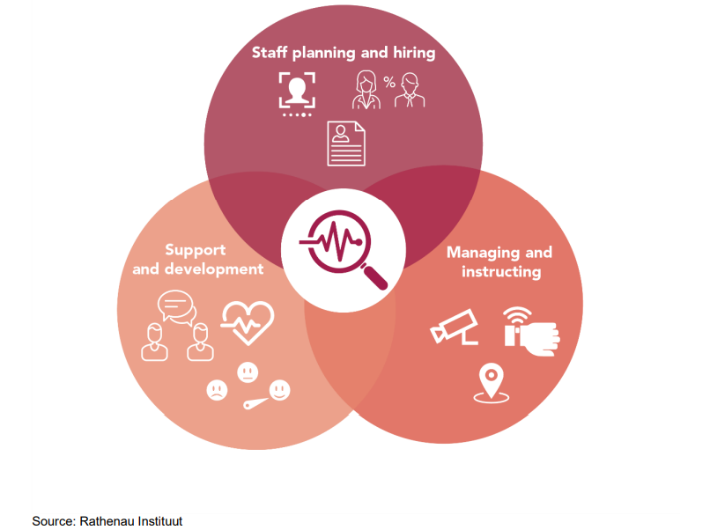
Tools that are currently on the market

Slide 10
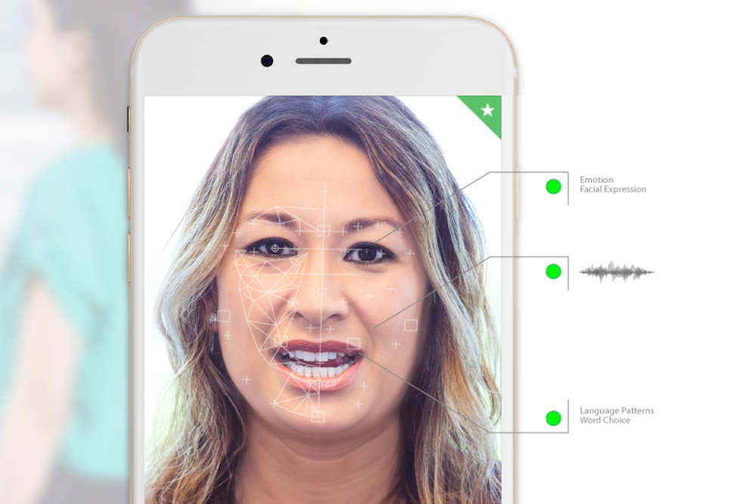
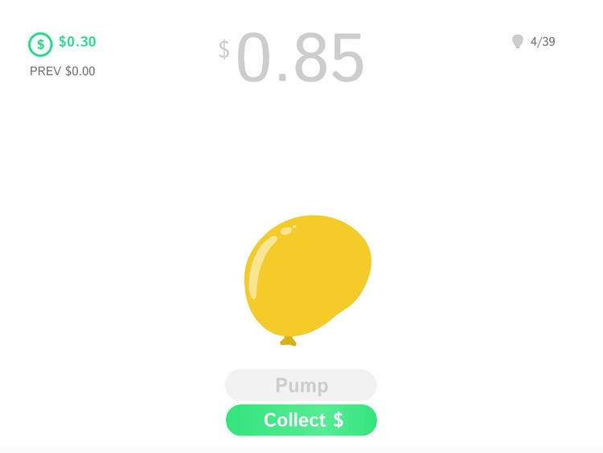
Staff planning and hiring

Slide 11
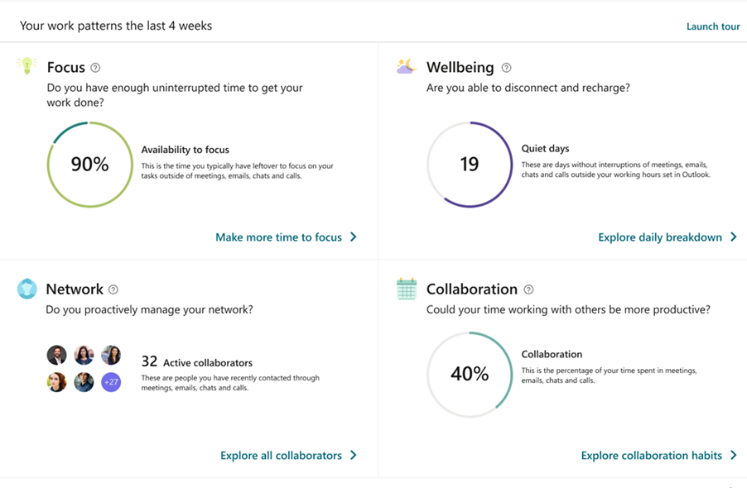
Support and development

Slide 12

Managing and instructing

Slide 13
Limits of the technology
Underlying idea = fact-based management
Data are not ‘neutral’
What is regarded as valuable work is reduced to what can be quantified
“Not everything that can be counted counts and not everything that counts can be counted”

Slide 14
Impact on quality of work
Measuring workers is not ‘neutral’
Use of digital monitoring always has impact on quality of work
Not just privacy, but also work autonomy, fulfillment, relationships,..
(European) legal frameworks are successful in imposing requirements and restriction on the use of data, but not sufficient

Slide 15
The way forward
The important question is not
‘what is possible’ or ‘what is legal’
but ‘what do we want’?

